Slide 1
OSHA Recording/Reporting of Occupational Injuries and Illnesses
Gayle Luker
Safety Consultant Specialist
216-315-2650
Gayle.L.1@bwc.state.oh.us
Ohio BWC
Division of Safety & Hygiene

Slide 2
OSHA AREA OFFICES
TOLEDO AREA OFFICE
420 Madison Avenue
Toledo, Ohio 43604
(419) 259-7542
CLEVELAND AREA OFFICE
6393 Oak Tree Blvd, Suite 203
Independence, Ohio 44131
(216) 447-4194
CINCINNATI AREA OFFICE
36 TRIANGLE PARK DRIVE
CINCINNATI, OHIO 45246
(513) 841-4132
COLUMBUS AREA OFFICE
FEDERAL OFFICE BLDG. ROOM 620
200 NORTH HIGH STREET
COLUMBUS, OHIO 43215
(614) 469-5582

Slide 3
Recordable/Reportable Definitions
Recordable Event- An event that must be recorded on the OSHA 300 log based on the 1904.7 recording criteria.
Reportable Event- An event that must be reported to OSHA within 8-24 hours based on 1904.39 reporting criteria.

Slide 4
OSHA/BWC
OSHA injury and illness recordkeeping and workers’ compensation are independent of each other!
They are separate systems

Slide 5
OSHA Standard-1904
Are all employers required to keep/maintain these injury and illness forms? (Per 1904)
www.osha.gov

Slide 6
OSHA 1904
The industry that the employer is in (NAICS as of 1/12015)
And how many corporate employees. The magic number is 11 or more.
Some employers are partially exempt.

Slide 7
OSHA Publications
OSHA document 3745 lists the new reporting requirements as of 1/1/2015
OSHA document 3746 lists the newly partially exempt list as well as the new industries required to keep injury/illness records.

Slide 8
Occupational Injury
Any wound or damage to the body resulting from an event in the work environment
Cuts, puncture, lacerations, abrasion, fracture, bruise, contusion, chipped tooth, amputation, insect bite, electrocution or a thermal, chemical, electrical or radiation burn

Slide 9
Occupational Illness's
Skin diseases or disorders (dermatitis, rash)
  Respiratory conditions ( silicosis, asbestosis)
Poisoning (lead, mercury, cadmium, arsenic)
Hearing Loss
All other illnesses (heatstroke, sunstroke)

Slide 10
General Recording Criteria
1904.7
Work related Death
Work related loss of consciousness
Days away from work
Job restrictions/job transfer
Medical treatment beyond first aid
If a work related event results in any of the above it is a recordable event!!!

Slide 11
General Reporting Criteria 1904.39
Report a fatality within 8 Hours to the OSHA office or the toll free number
Report the in-patient hospitalization of one or more employees as a result of a work-related incident within 24 hours
1-800-OSHA (1-800-321-6742) or online

Slide 12
Reporting Criteria Effective 1/1/2015
All work-related inpatient hospitalizations of one or more employees (except for diagnostics)
All work-related amputations
All work-related losses of an eye
Employers must report the incident within 24 hours of learning about it.

Slide 13
Zero Recordable Events
You must still keep an OSHA log for that calendar year and post an OSHA 300A summary form.
What helped you achieve these accident prevention results?

Slide 14
OSHA PENALTIES
Willful, Repeat $ 70,000
Serious $ 7,000
Failure to Abate $210,000
Failure to Report Fatality $ 5,000
Failure to Post Citation $ 3,000
Failure to Post OSHA Poster $ 1,000
OSHA Recordkeeping Log $ 1,000
Failure to Post 300A Summary $ 1,000

Slide 17
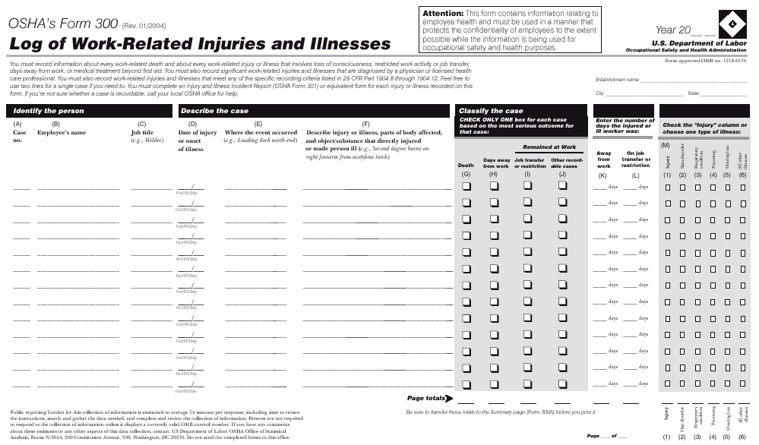

Slide 18
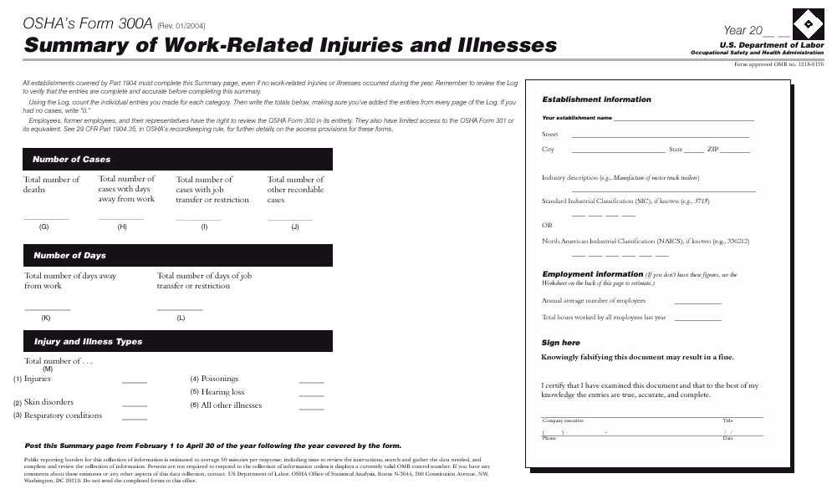

Slide 19
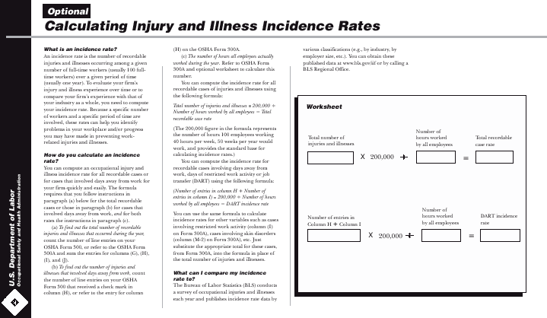

Slide 20
Medical Treatment
Defined as - means the management and care of a patient to combat disease or disorder.
Does not include;
  Visit to physician or other medical professional solely for observation or counseling.
  When diagnostic procedures, such as x-rays and blood tests, including prescription medication used solely for diagnostics.

Slide 21
First-Aid Treatment
The following is the list of first-aid treatment;
Non-prescription drugs in non-prescription strength
Administering a tetanus, (others like Hep B and rabies are recordable)
Cleaning, flushing or soaking wounds on the surface of the skin

Slide 22
First-Aid Treatment
Using wound coverings such as adhesive bandages, gauze pads, etc., or using butterfly bandages or steri-strips (Sutures, staples, etc. used to close wounds are recordable.)
Using hot or cold therapy
Using non-rigid means of support, such as elastic bandages, wraps, non-rigid back belts, etc. (Rigid devices used to immobilize are considered medical treatment.)

Slide 23
First-Aid Treatment
Drilling of a fingernail or toenail or draining a blister
Using an eye patch
Removing foreign body from the eye using only irrigation or a cotton swab
Removing splinters or foreign material from areas other than the eye by irrigation, tweezers, cotton swabs, or other simple means

Slide 24
First-Aid Treatment
Use of finger guards.
Using massages (physical therapy and chiropractic treatment are considered medical treatment.
Drinking fluids for relief of heat stress.
ART –Active Release Technique

Slide 25
What does OSHA issue citations for concerning 1904?
Not keeping a log during a year your employer was required.
Listing employee names for privacy cases.
Incomplete descriptions of events. (column F)
No 300A posting.

